Slide 1
Gesture Unit Segmentation
Yiqiao Li

Slide 2
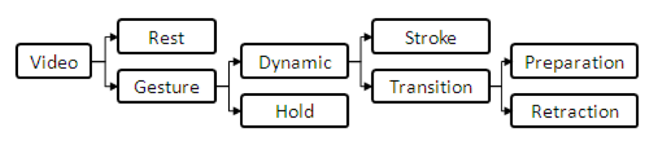
Gesture Phase Segmentation Data
9900 instances / 50 numeric features
Using Microsoft Kinect, we have obtained:
a image of each frame, identified by a timestamp;
a text file containing positions (coordinates x, y, z) of six articulation points: left hand, right hand, left wrist, right wrist, head and spine
velocity and acceleration
Each frame is segmented in gesture phases
E, S, H, P, R
{E, G}

Slide 3
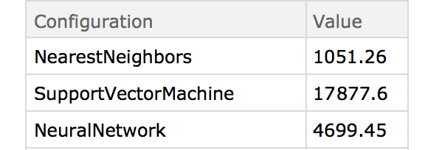
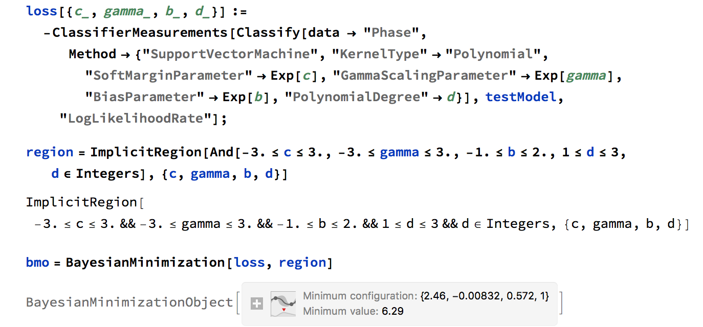
SVM result
SVM is not the best model for the dataset
NearestNeighbor and NN performs better
63.3% before tuning
Use BayesianMinimization to find optimal parameter
Accuracy: 78.5%

Slide 4
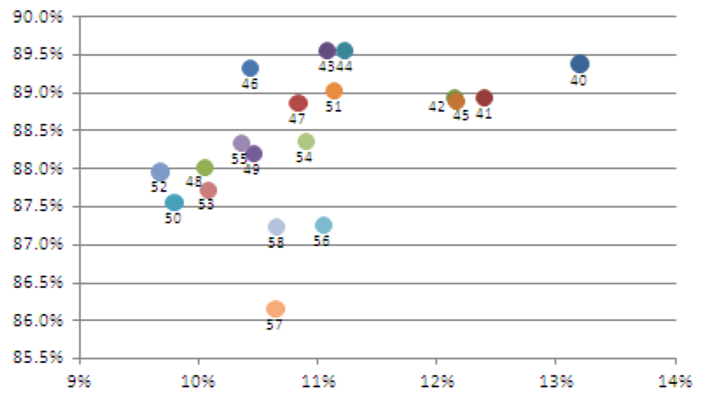
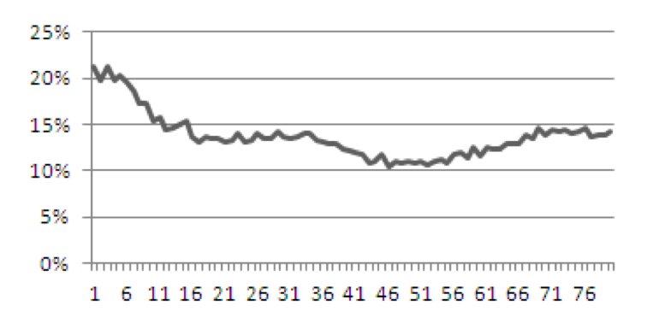
Comparison & Conclusion
Tuning:
84.3%
RBF
C = 100
Data preprocessing
Time window

